Slide 1

Team Profit Pioneers
MarketAI Suite: Intelligent Sales & Marketing Platform
Transform your go-to-market strategy with AI-powered campaign generation, intelligent pitch creation, and predictive lead scoring—all powered by Groq's LLaMA 3.3 70B.
Notes:
1

Slide 2



THE CHALLENGE
The Modern Sales & Marketing Dilemma
Teams Are Struggling
Generic Campaigns
Slow Response Times
One-size-fits-all messaging fails to resonate with diverse audiences
Hours spent crafting pitches that could be generated in seconds
Marketing and sales teams face mounting pressure to deliver data-driven results whilst managing increasingly complex buyer journeys and fragmented customer touchpoints.
Poor Lead Prioritisation
Sales teams waste time on low-quality leads without clear qualification metrics
Notes:
2

Slide 3


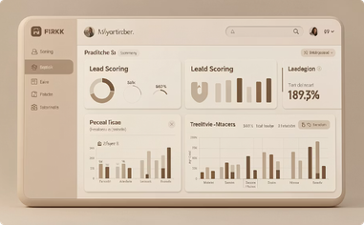
THE SOLUTION
MarketAI Suite: Your Intelligent Go-to-Market Engine
An advanced sales and marketing platform that leverages Groq's LLaMA 3.3 70B AI model to deliver comprehensive, data-driven support across your entire revenue operations.
AI Campaign Generation
Intelligent Pitch Creation
Predictive Lead Scoring
Create evidence-based marketing strategies with targeted content, compelling copy variations, and platform-optimised messaging in seconds.
Generate personalised, persuasive sales pitches tailored to specific prospects, complete with value propositions and strategic calls-to-action.
Quantify lead quality with AI-powered assessments across multiple qualification dimensions, enabling efficient resource allocation.
Notes:
3

Slide 4






HOW IT WORKS
The Power of Advanced AI Analysis
Lightning-Fast Processing
Groq's optimised infrastructure ensures rapid response times without sacrificing analytical depth
Sophisticated Analysis
LLaMA 3.3 70B delivers nuanced understanding of market dynamics and buyer behaviour
Input Data
AI Analysis
Generate Insights
Deliver Results
MarketAI Suite processes your product information, audience demographics, and lead attributes through Groq's optimised API, delivering sophisticated recommendations at unprecedented speed.
Actionable Outputs
Receive comprehensive strategies ready for immediate implementation
Notes:
4

Slide 5

USE CASE 1
AI-Generated Marketing Campaigns
Scenario: A marketing manager needs to launch a campaign for a new SaaS product targeting small business owners on LinkedIn.
1
2
Input Product & Audience Data
AI Analysis
Enter product details, target demographics, and platform specifications
MarketAI Suite processes information through Groq's advanced language model
3
Receive Comprehensive Strategy
Get campaign objectives, 5 targeted content ideas, 3 ad copy variations, and platform-specific CTAs
Notes:
5

Slide 6

USE CASE 2
Intelligent Sales Pitch Generation
Scenario: A sales representative pitches B2B enterprise software to a Fortune 500 IT Director.
MarketAI Suite creates personalised, compelling pitches that address enterprise pain points and move prospects to the next sales stage.
30-Second Elevator Pitch
Clear Value Proposition
Concise value communication for time-constrained executives
Quantified business impact aligned to prospect priorities
Key Differentiators
Strategic Call-to-Action
Competitive advantages addressing specific enterprise challenges
Next-step recommendations to advance the sales process
Notes:
6

Slide 7
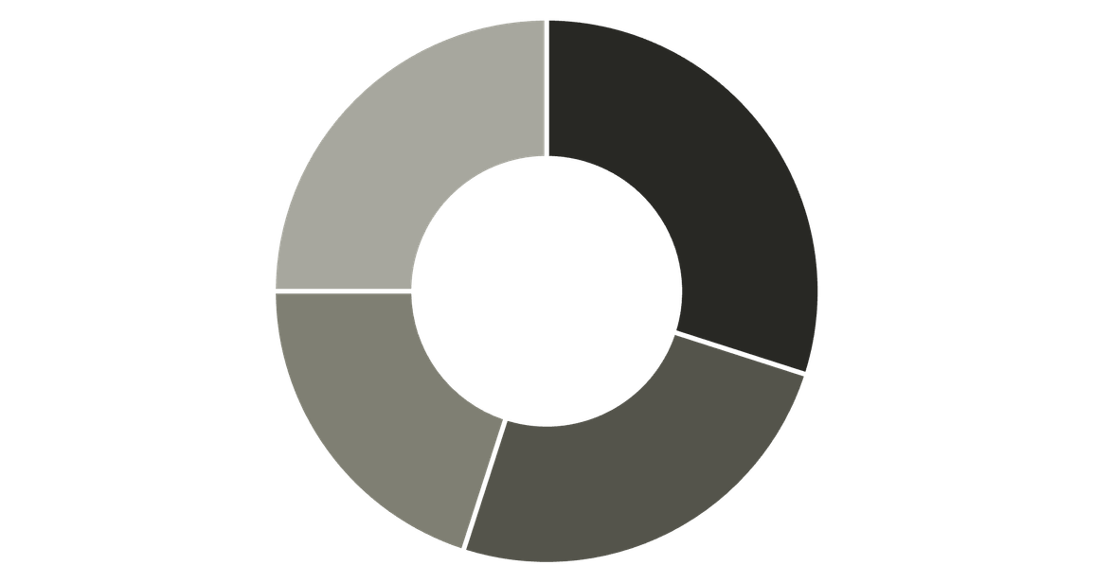
USE CASE 3
Lead Qualification & Scoring
Scenario: Sales team receives a lead with £50,000 budget, immediate implementation needs, and high urgency.
AI-Powered Assessment
MarketAI Suite analyzes lead attributes across multiple qualification dimensions to deliver actionable intelligence for your sales team.
Budget
Timeline
Authority
Need
87
76%
High
Lead Score
Conversion Probability
Priority Level
Quantified quality assessment (0-100 scale)
Data-driven likelihood of closing
Recommended outreach urgency
Notes:
7

Slide 8




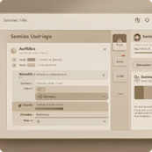
KEY BENEFITS
Transform Your Revenue Operations
Accelerated Time-to-Market
Enhanced Targeting Precision
Improved Sales Efficiency
Intuitive User Experience
Generate comprehensive campaigns and pitches in seconds, not hours. Deploy marketing strategies whilst your competition is still planning.
AI-powered analysis ensures messaging resonates with specific audience segments, increasing engagement and conversion rates.
Prioritise high-quality leads with confidence, allocating resources to opportunities with the highest conversion probability.
Modern interface designed for rapid adoption across marketing and sales teams, requiring minimal training.
Notes:
8

Slide 9

Why Groq's LLaMA 3.3 70B?
Unmatched Speed
Groq's optimised infrastructure delivers rapid inference times without compromising analytical depth
Advanced Reasoning
70B parameter model provides sophisticated understanding of complex marketing and sales scenarios
Enterprise Reliability
Production-grade API ensures consistent performance for mission-critical revenue operations
Technical Excellence: MarketAI Suite harnesses Groq's cutting-edge language processing capabilities to deliver enterprise-grade AI analysis that scales with your business needs.
Notes:
9

Slide 10




Ready to Transform Your Go-to-Market Strategy?
Join forward-thinking organisations leveraging AI to create targeted campaigns, craft persuasive pitches, and prioritise high-value leads efficiently.
Accelerate Revenue Growth
Improve Conversion Rates
Optimise Team Efficiency
Notes:
10

Slide 11
Thank You
Notes:
11

